Slide 1
Amortized Analysis
Week 3 / Lecture 3
Franck Chauvel
axbit & NTNU
franck.chauvel@ntnu.no

Slide 2
Insertion in a Sequence
void
insert (Sequence* sequence, int index, int item) {
assert(index > 0 && index <= sequence->length+1);
if (sequence->length == sequence->capacity) resize(sequence, 2);
int each = sequence->length;
while(each > index) {
set(sequence, each+1, get(sequence, each));
each--;
}
sequence->buckets[index-1] = item;
sequence->length++;
}

Slide 3
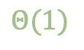

Best Case? Insertion in a sequence
Array is not full
Insertion at the end
$Θ(1)$
size
$$Θ(1)$$
input size

Slide 4

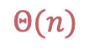
Worst Case? Insertion in a sequence
Array is full
Insertion at first
$Θ(n)$
size
$$Θ(n)$$
$$Θ(1)$$
input size

Slide 5

Average Case? Insertion in a sequence
F = 1 iff full, 0 otherwise
C: number of items to shift
$Exp[time\left(n, F, C\right)]$
size
$$Θ(n)$$
$$Θ(1)$$
input size

Slide 6
What do we miss?
resize
(capacity = 32)
time spent
resize
(capacity = 16)
resize
capacity =8
resize
capacity = 4
nb. insertions

Slide 7
Amortized Analysis

Slide 8
Methods
Aggregate
Method
Banker’s
Method
Physicist
Method

Slide 9
The idea The Banker’s Method
Spread “spikes” over other “cheaper” calls
Overestimate “cheap” calls
Understimate “expensive” calls
nb. insertions

Slide 10
Charging “1” Extra Take #1
Length | Capacity | Cost | Extra | Savings
0 | 2 |  |  | 0
1 | 2 | 1 | 1 | 1
2 | 2 | 1 | 1 | 2
3 | 4 | 2+1 | 0 | 0
4 | 4 | 1 | 1 | 1
5 | 8 | 4+1 | 0 | -3

Slide 11
Charging “2” Extra Take #2
Length | Capacity | Cost | Extra | Credit
0 | 2 |  |  | 0
1 | 2 | 1 | 2 | 2
2 | 2 | 1 | 2 | 4
3 | 4 | 2+1 | 2 | 3
4 | 4 | 1 | 2 | 5
5 | 8 | 4+1 | 2 | 2
6 | 8 | 1 | 2 | 4
7 | 8 | 1 | 2 | 6
8 | 8 | 1 | 2 | 8
9 | 16 | 8+1 | 2 | 1

Slide 12
How to Prove it?
By induction

Slide 13
Proof by Induction
Show it works for the initial condition
Induction Step
Assume it works for a spike k
Show it works until the next spike k+1

Slide 14
Initial Conditions Proof by Induction
Length | Capacity | Cost | Extra | Credit
0 | 2 |  |  | 0
1 | 2 | 1 | 2 | 2
2 | 2 | 1 | 2 | 4
3 | 4 | 2+1 | 2 | 3

Slide 15
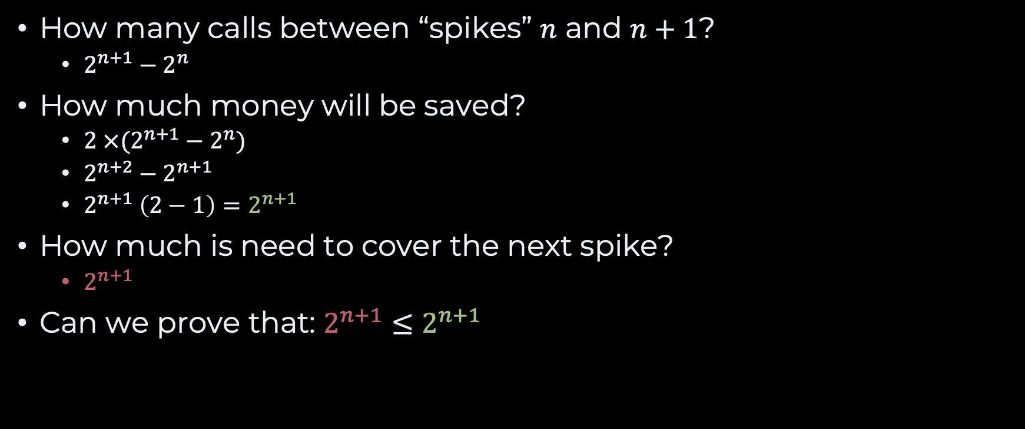
Induction Step Proof by Induction
How many calls between “spikes” $n$ and $n+1$?
$2^{n+1}−2^{n}$
How much money will be saved?
$2 ×(2^{n+1}−2^{n})$
$2^{n+2}−2^{n+1}$
$2^{n+1} \left(2−1\right)=2^{n+1}$
How much is need to cover the next spike?
$2^{n+1}$
Can we prove that: $2^{n+1}≤2^{n+1}$

Slide 16
Conclusion
The “cost of resizing” can be “amortized”
Does not really matters
because it does not happen often

Slide 17
Recap
Sequence of operations
“Once in a while” job
Amortized Analysis
Total cost of n operations number of operations
Adaptive data structures

Slide 18
Questions, Comments, or Ideas?
Franck Chauvel
axbit & NTNU
franck.chauvel@ntnu.no

Slide 19
Remember Arrays?
MEMORY:
Arrays
Contiguous memory allocation
Fixed-capacity
Variable length
What do we do when the array is full?
base address:
123
1
bucket
1
2
length
2
capacity
3
3
?
?

Slide 20
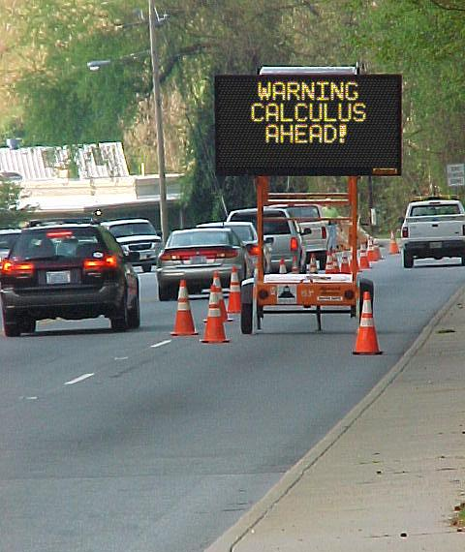
Agenda
Static Arrays
Dynamic Arrays
Amortized Analysis
Aggregate Method
Accounting method
Recap

Slide 21
Insertion Efficiency?
Time:
At the end: O(1)
Random O(n)
Requires shifting elements!
Space
O(1)
int static_push(Array* array, int value) {
if (is_full(array)) return 2;
array->length += 1;
array->content[array->length] = value;
}

Slide 22
Dynamic Arrays
Allocate more memory when we need!
When to grow/shrink?
How much to grow/shrink?
int dynamic_push(Array* array, int value) {
if (is_full(array)) {
Array* old_array = array->content;
array->capacity += 10;
array->content = malloc(array->capacity * sizeof(int));
for (int index=0 ; index<array->length ; index++) {
array->content[index] = old_array[index];
}
free(old_array);
}
array->length += 1;
array->content[array->length] = value;
}

Slide 23
Average Time?
An efficiency model:
A random variable:

Slide 24
What Does That Say?
 | Capacity
Length | c=2 | c=3 | c=4 | c=5 | c=100
0 | 1 | 1 | 1 | 1 | 1
1 | 1 | 1 | 1 | 1 | 1
2 | 4 | 1 | 1 | 1 | 1
3 |  | 5 | 1 | 1 | 1
4 |  |  | 6 | 1 | 1
5 |  |  |  | 7 | 1
100 |  |  |  |  | 102
Average | 2 | 2 | 2 | 2 | 2

Slide 25
What Does it Misses?
We don’t pick arrays at random
Sequence of operations
Over the same array
What happens once we have resized the array?
?
?
1
?
time = 1
full
1
2
time = 1
full
1
2
3
time = 4
full
1
2
3
4
time = 5
full
1
2
3
4
5
time = 6
full
1
2
3
4
5
6
time = 7

Slide 26
Amortized Analysis
Same data structure
Sequence of operations
3 methods
Aggregate method
Banker’s method
Physicist’s method
?
?
1
?
time = 1
full
1
2
time = 1
full
1
2
3
time = 4
full
1
2
3
4
time = 5
full
1
2
3
4
5
time = 6
full
1
2
3
4
5
6
time = 7

Slide 27
Amortized vs. Average
Average Case
Amortized
One operations
Many possible inputs
Probabilistic assumption
Many operations
One data structure
Often, for “house cleaning” in the data structure

Slide 28
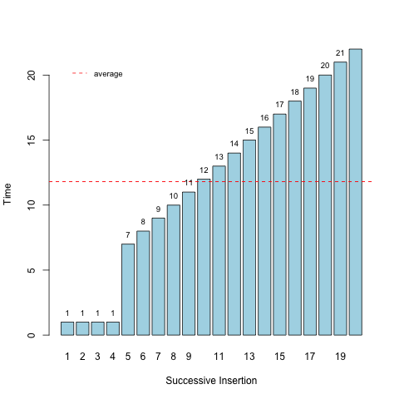
The Aggregate Method

Slide 29
The Aggregate method
An efficiency model:

Slide 30

The Banker’s Method
We sell our algorithms as a service
We pay for the CPU & Memory we use
Some operation are more expensive than other
How much shall we charge to make a living?

Slide 31
Banker’s method
Devise a “gain” for each operation
Show that the balance never gets negative
Your gain is your upper bound

Slide 32
Example: Adding k new buckets
int dynamic_push(Array* array, int value) {
if (is_full(array)) {
Array* old_array = array->content;
array->capacity += 5;
array->content = malloc(array->capacity * sizeof(int));
for (int index=0 ; index<array->length ; index++) {
array->content[index] = old_array[index];
}
free(old_array);
}
array->length += 1; // Prout
array->content[array->length] = value;
}

Slide 33

What Does it Cost?
time
copy
insertion
allocation
$k$: expansion
1
5
10
15
insertions

Slide 34
What Should we Charge?
time
copy
insertion
allocation
1
5
10
15
insertions

Slide 35
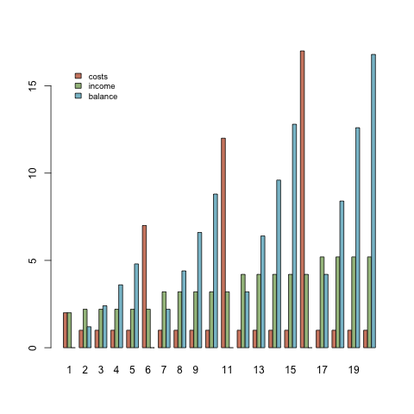
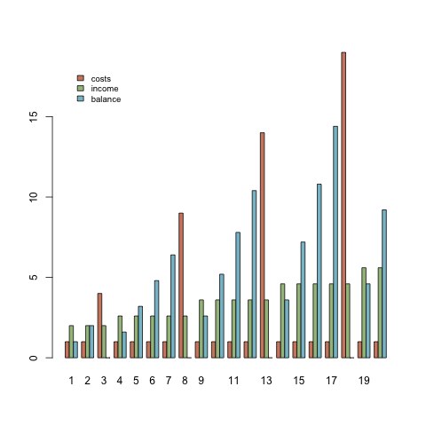
Does that Work?

Slide 36
How to Prove it?
Proof by induction
Two steps
Show it works for the first step
Assume no funds at first
Show that
Provided it work one step,
It works for the next

Slide 37
A Proof
Take it expansion by expansion
Step 1:
Show it works for the first expansion

Slide 38
A Proof
Take expansion by expansion
Step 2
If the balance is not negative after an expansion
It should remains non negative after the next

Slide 39
A Proof

Slide 40

About Calculus
Don’t fear Greek symbols
It is just a syntax
Understand
Work out examples

Slide 41
Recap
Dynamic Arrays
Allocate memory as we need
Amortized Analysis
Different from average analysis
Efficiency of a sequence of operations
Useful for self-adaptive data structures
3 Methods
Aggregate
Banker’s method
Physicist’s method

Slide 42
Run-length Encoding (RLE) Lab Session
list “runs” with their length
Implement:
convertion
insertion
deletion
search
compression ratio?
1 run
input array
1
1
3
4
5
6
6
6
6
6
3
3
2 x 1
1 x 4
5 x 6
2 x 3
1 x 3
1 x 5
2
1
1
3
1
4
1
5
5
6
2
3
output array

